Slide 1
Computer Vision Traffic Sign Classification

Slide 2

Made by
Divyanshu Mishra
Computer Science and Engineering

Slide 3
Project analysis slide 2
Project Blueprint
IMPLEMENT
Apply the model for real
time detection of objects
using OpenCV library
SPECIFICATION
A multi-class classifier that
can classify more than 40
different signs.
Traffic Signs Classifier
TESTING
Testing the model on test sets
and increasing accuracy by
Tuning SVM, DNN,CNN.
DESIGN
Classifier models using SVM,
Deep NN and Convolutional NN
2. Pre-processing real time images/videoframes using OpenCV to classify the objects.

Slide 4
Project analysis slide 3
Project Blueprint
The data is ready for training. That means it has been processed to detect in different conditions – increased/decreased amount of light and size of image.
Training an SVM model to learn from the data. Tuning SVM to produce better results.
To increase accuracy further:-
1. Using Deep Neural Networks
2. Using Convolutional Neural Networks
Using OpenCV functions to
detect and process images/videoframes in real time to make it usable to be fed into the model. It includes cropping , gray scaling, edge detection.
The training data is taken from Kaggle. It consists of more than 40 classes of traffic signs.

Slide 5
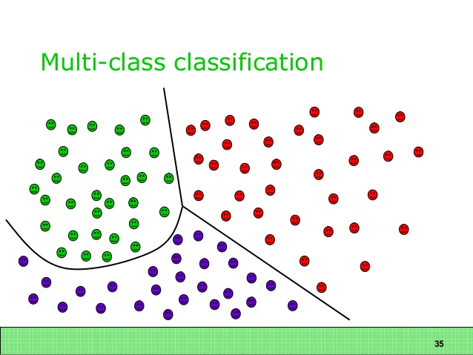
Project analysis slide 4
Project Blueprint
SVM model for multiclass classification classifies data with respect to decision boundaries.
The classification accuracy of SVM model can be levelled up using hyper tuning. It involves changing the kernel and bias-variance coefficient.

Slide 6
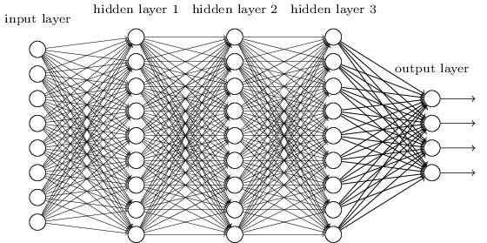
Project analysis slide 4
Project Blueprint
Deep Neural Networks can be used to achieve higher accuracy. The image is fed as a vector of its grayscale values.
This Photo by Unknown Author is licensed under CC BY-NC
The hidden layers are used to derive more complex attributes as a function of pre-existing attributes. Final result is a multi-class classifier.

Slide 7
Project analysis slide 3
Project Blueprint
Languages/libraries used-
Python/ i-python notebook
OpenCV
Tensor-flow/ Pytorch
Scikit-Learn
NumPy, Pandas, Matplotlib

Slide 8
Thank You

